Slide 1

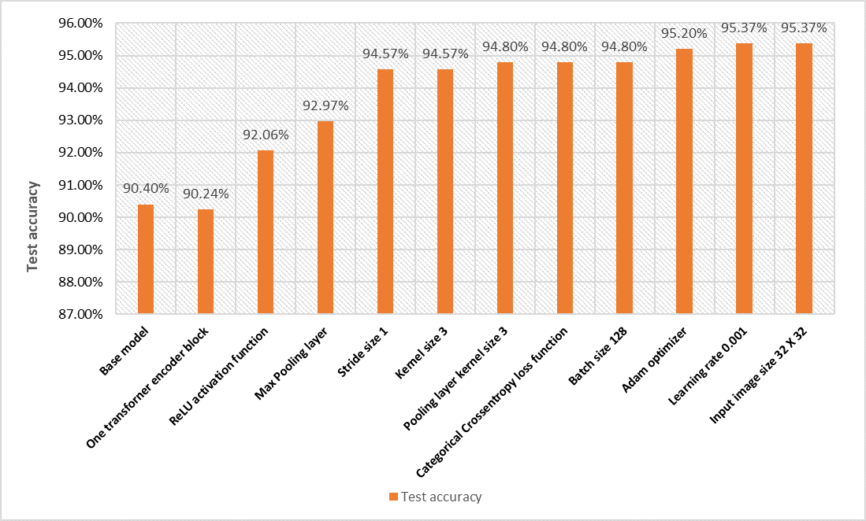
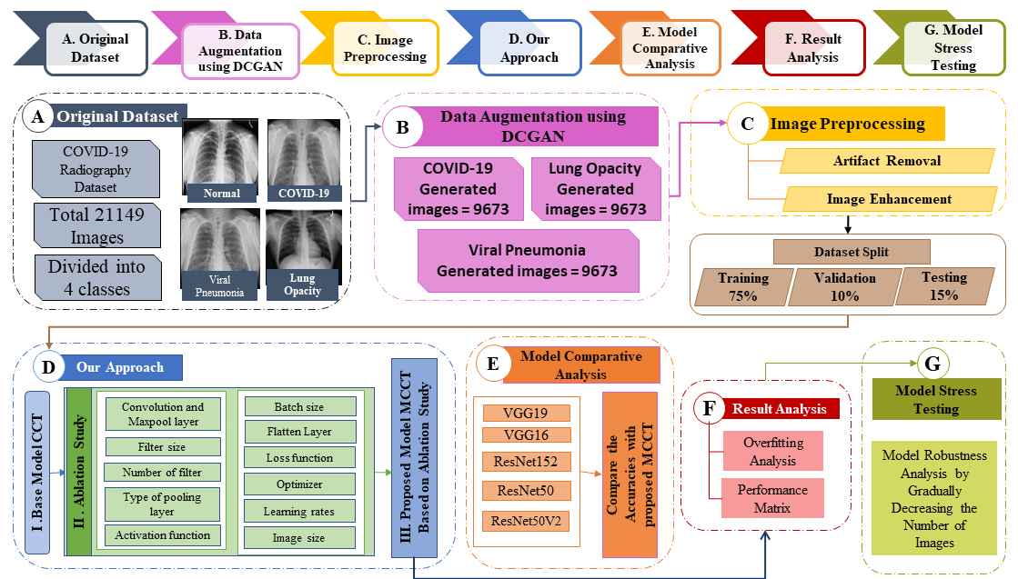
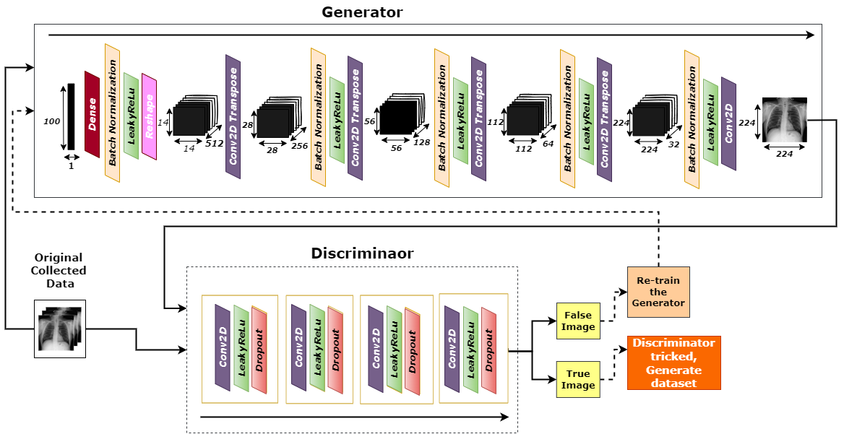
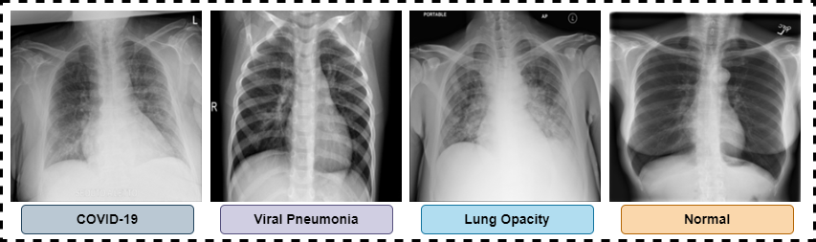
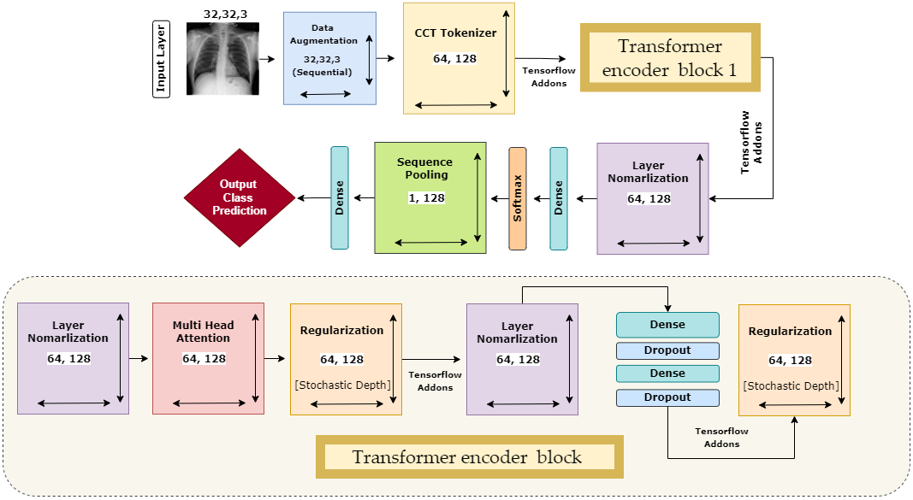
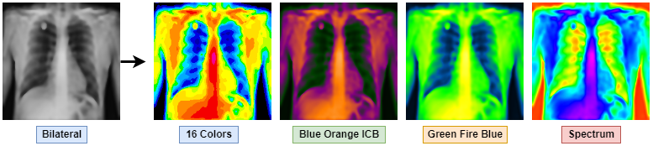
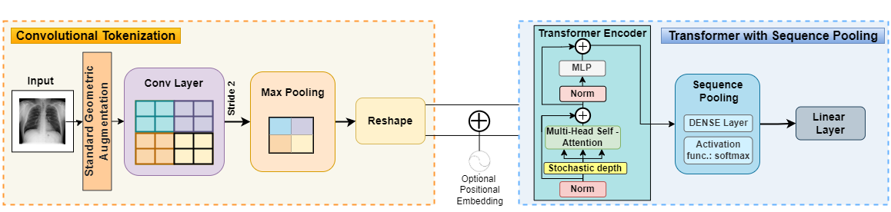
An Effective Approach to Address Processing Time and Computational Complexity Employing Modified CCT for Lung Disease Classification
INTRODUCTION
RESULTS
In this study, the COVID-19 Radiography dataset is used for the automatic detection and classification of lung diseases into COVID-19, Normal, Lung Opacity, and Viral Pneumonia. In this context, the issues of training time and complexity, smaller medical datasets, imbalanced number of images and dealing with low resolution images are addressed with noteworthy performance, The main contributions can be summarized as follows:
i. The dataset used for the experiment, contains imbalance number of images. The dataset is balanced by Generative Adversarial Network (GAN).
ii. A number of image pre-processing techniques are carried out to remove artefacts and enhance the quality of the images.
iii. To address the issues of high training time and low numbers of images, we propose a model named MCCT by modifying an original CCT model for the automatic classification of lung diseases.
iv. An ablation study is performed by changing different hyper-parameters and the layer architecture of the proposed model to further improve the performance.
v. Several transfer learning models, are applied to our dataset to compare the performance of the proposed MCCT model.
vi. To evaluate the generalization capability and sustainability of our model even further in terms of volume of the training dataset, the model is trained four times, gradually decreasing the number of images.
vii. From result it is found that our proposed MCCT model outperforms the transfer learning models in terms of accuracy and training time while using 32×32 sized images as training data.
Table : Performance comparison with six states of the art transfer learning CNN models.
Model | Number of params | epochs | Total time | Per epoch time | optimizer | Batch size | Image size | Learning rate | accuracy
VGG19 | 20,026,436 | 100 | 01:50-02:00H | 61-63s | Adam | 128 | 32 | 0.001 | 76.97%
VGG16 | 14,716,740 | 100 | 01:50-02:00H | 61-63s | Adam | 128 | 32 | 0.001 | 79.51%
ResNet152 | 58,379,140 | 100 | 01:50-02:00H | 61-63s | Adam | 128 | 32 | 0.001 | 53.39%
ResNet50 | 23,595,908 | 100 | 01:50-02:00H | 61-63s | Adam | 128 | 32 | 0.001 | 67.77%
ResNet50V2 | 23,572,996 | 100 | 01:50-02:00H | 61-63s | Adam | 128 | 32 | 0.001 | 65.35%
MobileNet | 3,232,964 | 100 | 01:50-02:00H | 61-63s | Adam | 128 | 32 | 0.001 | 43.42%
MCCT | 241,861 | 100 | 18-20m | 11-12s | Adam | 128 | 32 | 0.001 | 95.37%
Intelligent Systems with Applications
1. Inam Ullah Khan, 2. Sami Azam*, 3. Sidratul Montaha, 4. Abdullah Al Mahmud, 5. A.K.M. Rakibul Haque Rafid, 6. Md. Zahid Hasan, 7 Mirjam Jonkman
1, 3, 4, 5: Health Informatics Research Laboratory (HIRL), Department of Computer Science and Engineering, Daffodil International University, Dhaka-1341, Bangladesh.
2*,6: College of Engineering, IT and Environment, Charles Darwin University, Casuarina, 0909, NT, Australia
METHODS AND MATERIALS
The Covid19 Radiography Chest X-ray dataset is used to conduct all the experiments in this study. The Data augmentation technique DCGAN is introduced to deal with the data imbalance problem by generating new images. Afterwards, several image pre-processing algorithms are applied on the augmented balanced dataset to remove the artefacts and enhance the images. Statistical analysis methods, Peak signal-to-noise ratio (PSNR), Mean Squared Error (MSE), and Root Mean Squared Error (RMSE), and the structural similarity index measure (SSIM), are used to assess ensure that image quality is not reduced. The pre-processed dataset is split into training, validation and testing before feeding the images into the deep learning models. We propose a MCCT model using an image size of 32 x 32 by modifying the layer architecture and hyper parameters of an original CCT model. An ablation study of eleven cases is done to ensure the best performance while addressing the time complexity. The performance of the MCCT model is compared with five deep learning models, VGG16, VGG19, ResNet152, ResNet50, ResNet50V2 and MobileNet, in terms of training time and accuracy for an image size of 32×32, Several performance metrics are evaluated and the possible occurrence overfitting is assessed. The robustness of the model is evaluated further by evaluating the performance with a decreasing the number of images. All processes are described briefly in the sections and sub-sections below
Figure 5: Improvement in test accuracy over 11 ablation studies.
ABSTRACT
CONCLUSIONS
Early identification and adequate treatment can in preventing lung disorders from becoming chronic, severe, and life-threatening. In the study of medical imaging using deep learning, two obstacles limit interpretability. One is an insufficient and imbalanced number of training samples in most medical datasets. The other is excessive training time. This study represents a solution to overcome these impediments by balancing the number of images and reducing overall processing time while preserving the accuracy. The quantity of data in the classes is balanced by creating synthetic images based on the patterns and characteristics of the original images, using a Deep Convolutional Generative Adversarial Network (DCGAN). Unwanted regions are removed from the X-ray images, the brightness and contrast of the images are enhanced, and the chest abnormality is highlighted by using different artefact removal, noise reduction, and enhancement techniques. We propose a Modified Compact Convolutional Transformer (MCCT) model using 32×32 sized images for the categorization of lung disorders into four classes by altering the original CCT model. An ablation study of nine cases is employed to adjust several hyper parameters and layer topologies which reduces training time while preserving accuracy. Six transfer learning models, VGG19, VGG16, ResNet152, ResNet50, ResNet50V2, and MobileNet are applied with the same image size to compare the performance of the proposed MCCT model. Our suggested MCCT model records the greatest test accuracy of 95.37%, requiring a low training time of 10-12 s/epoch, whereas the other models only reach near-moderate performance showing accuracies ranging from 43% to 79% and requiring training times of 80-90 s/epoch. Our proposed approach may contribute to an effective CAD based diagnostic system by addressing the issues of insufficient and imbalanced numbers of medical images, excessive training times and low-resolution images
A lung CAD system is developed in this work to classify lung images into four categories. DCGAN is applied to the dataset to balance the number of images and image pre-processing methods are utilized to eliminate noise and artifacts and to enhance the visibility of the ROIs of the images. We propose a MCCT model based on the original CCT model, as it outperforms CNNs in computational efficiency and accuracy. Our proposed network is subjected to ablation research in order to assess and improve the model's robustness, resulting in a training accuracy of 95.37%, a precision of 95.34%, a recall of 95.44% and an F1-score of 95.39%. The proposed model is compared with six transfer learning models, VGG19, VGG16, ResNet152, ResNet50, ResNet50V2, and MobileNet in terms of accuracy and training time. For the same set of 32×32-pixel images, the other models have accuracies ranging from 43% to 77%, whereas our model has an accuracy of 95.37%. The results of this study show that our suggested technique has produced an accurate lung disease classification model, when trained with 32×32-pixel input images. When training with large datasets, smaller size images might result in shorter training times and less storage space, which can be very advantageous. Our model also minimizes the number of trainable parameters, reducing the training time. The proposed model may help to correctly classify lung X-ray images in a very short time. Finally, we wish to evaluate the MCCT in a variety of datasets in order to assess its generalization and robustness in different medical image classification tasks.
Figure 1. Complete methodology
Figure 2. GAN Architecture
REFERENCES
CONTACT
Hassani, A., Walton, S., Shah, N., Abuduweili, A., Li, J., Shi, H., 2021. Escaping the big data paradigm with compact transformers.
Montaha, S., Azam, S., Rafid, A.K.M.R.H., Ghosh, P., Hasan, M.Z., Jonkman, M., de Boer, F., 2021. BreastNet18: A high accuracy fine-tuned VGG16 model evaluated using ablation study for diagnosing breast cancer from enhanced mammography images. Biology (Basel) 10, 1347.
Bowles, C., Chen, L., Guerrero, R., Bentley, P., Gunn R and Hammers, A., Dickie, D.A., Hernández, M. v, Wardlaw, J., Rueckert, D., 2018. Gan augmentation: Augmenting training data using generative adversarial networks.
Dosovitskiy A, Beyer L, Kolesnikov A, Weissenborn D, Zhai X, Unterthiner T, et al. An Image is Worth 16x16 Words: Transformers for Image Recognition at Scale. 2020 [cited 20 Oct 2022]. doi:10.48550/arxiv.2010.11929
Md. Zahid Hasan
Health Informatics Research Lab
Daffodil International University
Email: zahid.cse@gmail.com
Phone: +8801672-580748
Website:
https://sites.google.com/diu.edu.bd/diu-hirl/home
Figure 3. Image preprocess and CCT architecture.
Figure 4. Proposed Model Architecture

